Slide 1
Sartorious Experiments Summary Statistics

Slide 2
Table of best viscosity parameters: (manual testing)
 | Parameters: |  |  |  |  | % error (blowouts before)
Viscosity standard: | Aspiration rate: | Dispense rate: | Delay aspirate: | Delay dispense: | Time for 1000ul | 1000(ul) | 500(ul) | 300(ul)
204 | 150.0 | 15.0 | 10 | 10 | 93.333333 | -0.383575 | -1.518704 | -2.589177
398 | 80.0 | 15.0 | 10 | 10 | 99.166667 | -1.767441 | -1.275127 | -3.49754
505 | 50.0 | 5.0 | 10 | 10 | 240.000000 | -1.031009 | -1.581433 | -3.491137
817 | 10.0 | 5.0 | 10 | 10 | 320.000000 | -2.759218 | -3.829765 | -4.086789
1275 | 4.0 | 2.5 | 10 | 10 | 670.000000 | -2.467078 | -3.796428 | -2.442059

Slide 3
Table of best viscosity parameters: (BOTorch Experiment 2)
 |  | Parameters:
Viscosity standard: | Volume: | Aspiration rate: | Dispense rate: | Delay aspirate: | Delay dispense: | Time for 1000ul | % error(blowouts before)
204 | 300 | 114.512228 | 21.217443 | 10 | 10 | 75.863723 | -2.516088
 | 300 | 81.16671 | 13.787268 | 10 | 10 | 104.851008 | -1.138641
 | 500 | 75.041981 | 18.239168 | 10 | 10 | 88.152937 | -0.472968
 | 1000 | 72.83177 | 15.894114 | 10 | 10 | 96.646646 | -2.098918
505 | 300 | 44.717819 | 9.656528 | 10 | 10 | 145.91934 | -0.464922
 | 500 | 57.178353 | 9.26094 | 10 | 10 | 145.469537 | -1.708971
 | 1000 | 76.261096 | 16.650269 | 10 | 10 | 93.171934 | -1.468999
817 | 300 | 18.027723 | 8.830124 | 10 | 10 | 188.718812 | -3.56471
 | 500 | 16.438385 | 7.963184 | 10 | 10 | 206.411129 | -1.56475
 | 1000 | 15.946734 | 13.577798 | 10 | 10 | 156.35841 | -2.210176
1275 | 300 | 3.867115 | 4.755213 | 10 | 10 | 488.886211 | -7.390287
 | 500 | 6.522269 | 5.229181 | 10 | 10 | 364.555419 | -3.853138
 | 1000 | 10.888369 | 8.013913 | 10 | 10 | 236.624113 | -4.110001

Slide 4
Table of best viscosity parameters: (BOTorch Experiment 3)
 | Parameters: |  |  |  |  | % error (blowouts before)
Viscosity standard: | Aspiration rate: | Dispense rate: | Delay aspirate: | Delay dispense: | Time for 1000ul | 1000(ul) | 500(ul) | 300(ul) | mean
204 | 102.939013 | 15.379469 | 10 | 10 | 94.736242 | -1.985911 | -0.948609 | -2.128154 | -1.687558
505 | 43.183051 | 7.278616 | 10 | 10 | 180.545995 | -1.618352 | -1.779452 | -1.975233 | -1.791012
817 | 16.438385 | 7.963184 | 10 | 10 | 206.411129 | -0.573375 | -2.046668 | -3.174586 | -1.931543
1275 | 4.095164 | 6.424205 | 10 | 10 | 419.851735 | -2.824018 | -3.963222 | -5.928058 | -4.238433

Slide 5
Table of best viscosity parameters: (IPOPT Experiment 2)

Slide 6
Table of best viscosity parameters: (IPOPT Experiment 3)

Slide 7
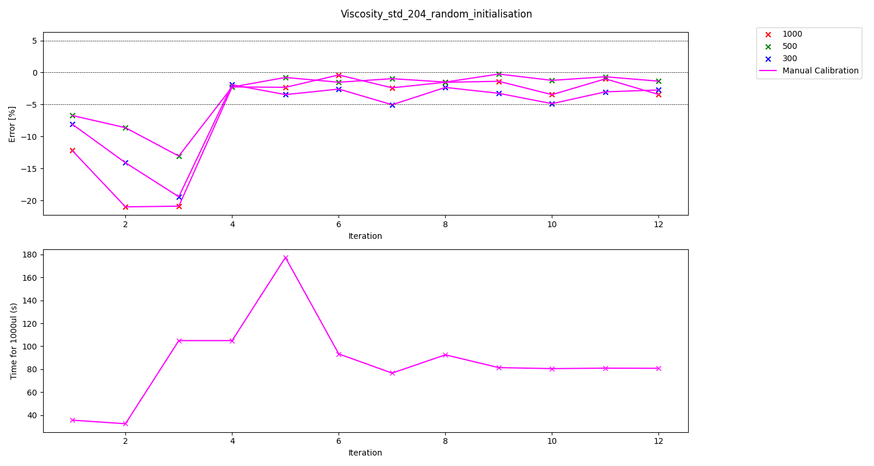
Graph of experiment results (Viscosity standard 204 manual)
 | Parameters: |  |  |  |  | % error (blowouts before)
Viscosity standard: | Aspiration rate: | Dispense rate: | Delay aspirate: | Delay dispense: | Time for 1000ul | 1000(ul) | 500(ul) | 300(ul)
204 | 150.0 | 15.0 | 10 | 10 | 93.333333 | -0.383575 | -1.518704 | -2.589177

Slide 8
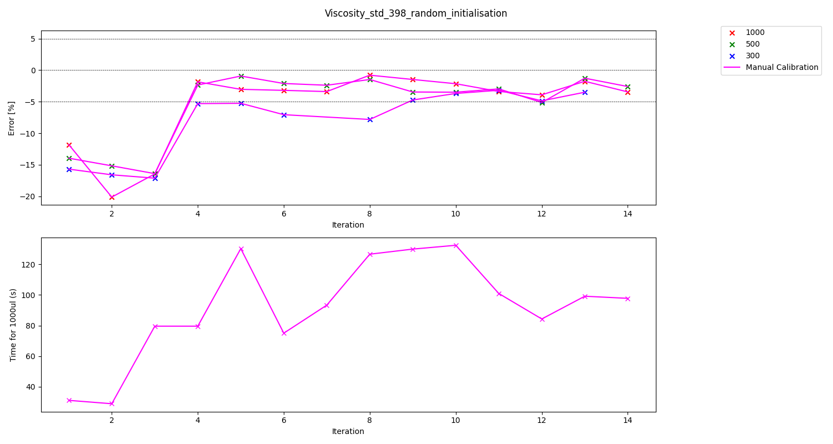
Graph of experiment results (Viscosity standard 398 manual)
 | Parameters: |  |  |  |  | % error (blowouts before)
Viscosity standard: | Aspiration rate: | Dispense rate: | Delay aspirate: | Delay dispense: | Time for 1000ul | 1000(ul) | 500(ul) | 300(ul)
398 | 80.0 | 15.0 | 10 | 10 | 99.166667 | -1.767441 | -1.275127 | -3.49754

Slide 9
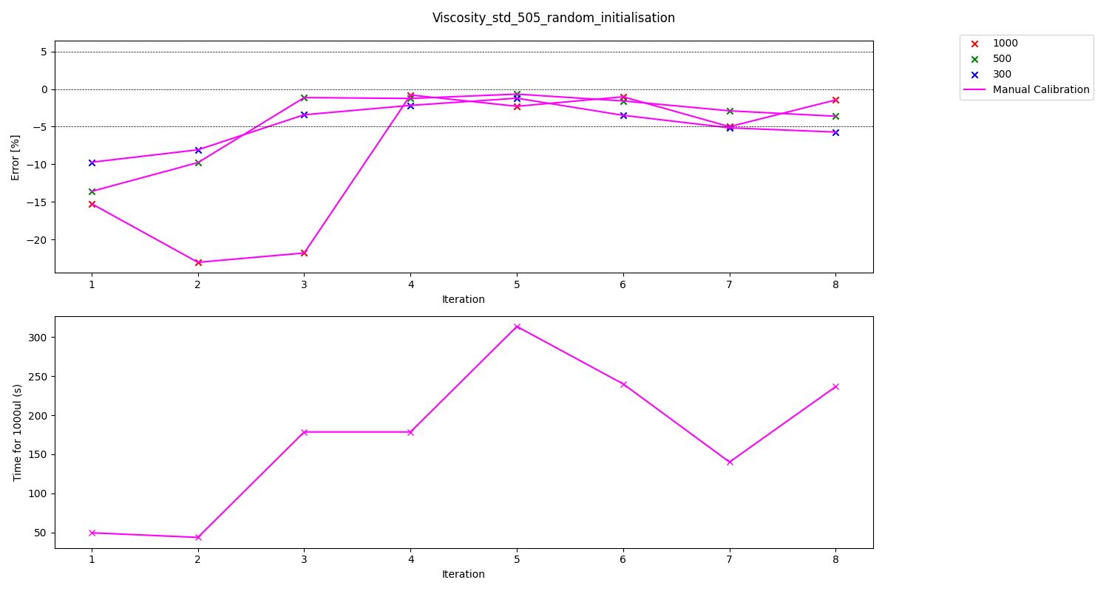
Graph of experiment results (Viscosity standard 505 manual)
 | Parameters: |  |  |  |  | % error (blowouts before)
Viscosity standard: | Aspiration rate: | Dispense rate: | Delay aspirate: | Delay dispense: | Time for 1000ul | 1000(ul) | 500(ul) | 300(ul)
505 | 50.0 | 5.0 | 10 | 10 | 240.000000 | -1.031009 | -1.581433 | -3.491137

Slide 10
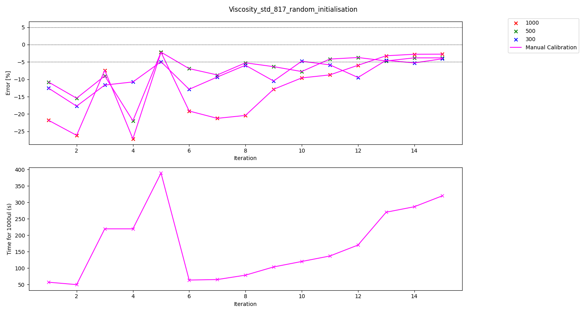
Graph of experiment results (Viscosity standard 817 manual)
 | Parameters: |  |  |  |  | % error (blowouts before)
Viscosity standard: | Aspiration rate: | Dispense rate: | Delay aspirate: | Delay dispense: | Time for 1000ul | 1000(ul) | 500(ul) | 300(ul)
817 | 10.0 | 5.0 | 10 | 10 | 320.000000 | -2.759218 | -3.829765 | -4.086789

Slide 11
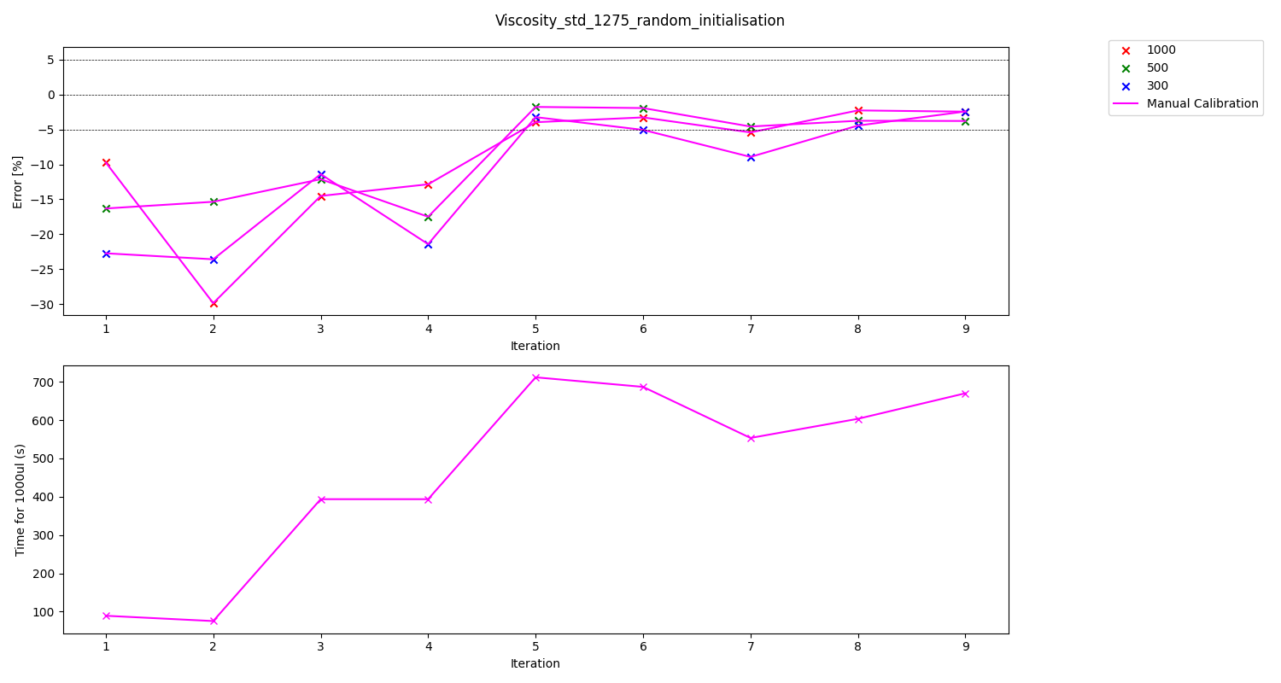
Graph of experiment results (Viscosity standard 1275 manual)
 | Parameters: |  |  |  |  | % error (blowouts before)
Viscosity standard: | Aspiration rate: | Dispense rate: | Delay aspirate: | Delay dispense: | Time for 1000ul | 1000(ul) | 500(ul) | 300(ul)
1275 | 4.0 | 2.5 | 10 | 10 | 670.000000 | -2.467078 | -3.796428 | -2.442059

Slide 12
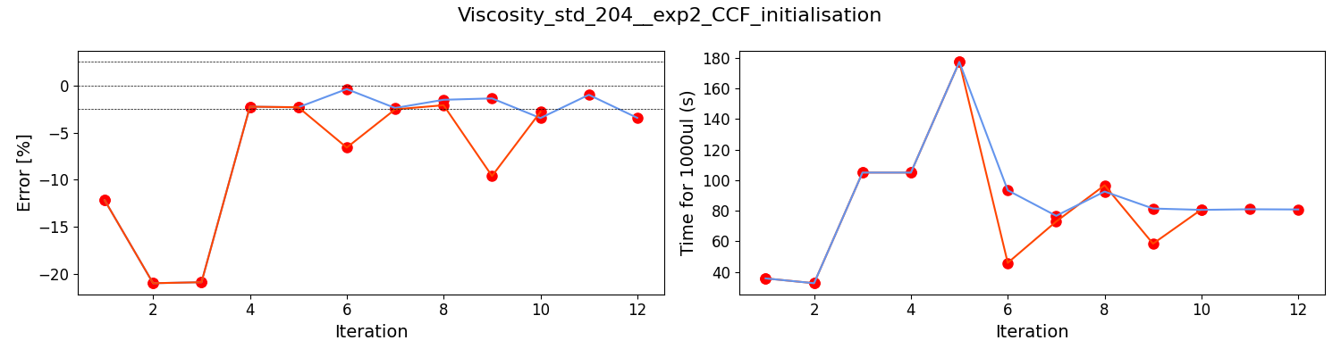
Graph of experiment results (Viscosity standard 204 BOTorch exp 2)
Viscosity standard: | Volume: | Aspiration rate: | Dispense rate: | Delay aspirate: | Delay dispense: | Time for 1000ul | % error(blowouts before)
204 | 300 | 114.512228 | 21.217443 | 10 | 10 | 75.863723 | -2.516088
 | 300 | 81.16671 | 13.787268 | 10 | 10 | 104.851008 | -1.138641
 | 500 | 75.041981 | 18.239168 | 10 | 10 | 88.152937 | -0.472968
 | 1000 | 72.83177 | 15.894114 | 10 | 10 | 96.646646 | -2.098918

Slide 13
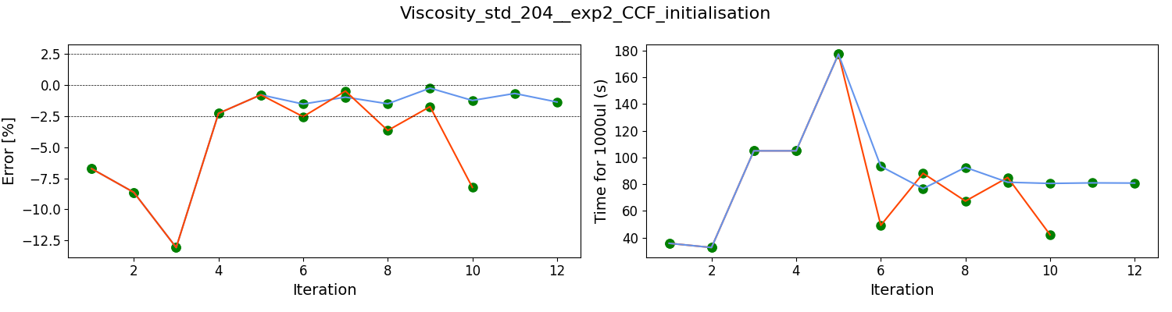
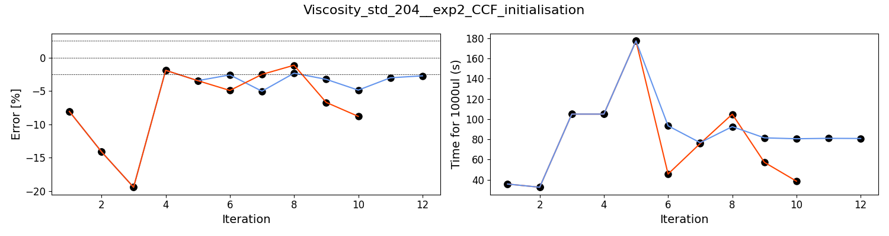

Slide 14
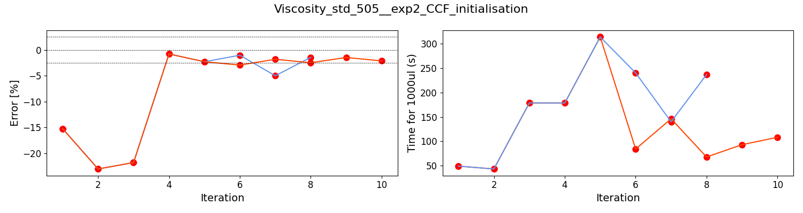
Graph of experiment results (Viscosity standard 505 BOTorch exp 2)
Viscosity standard: | Volume: | Aspiration rate: | Dispense rate: | Delay aspirate: | Delay dispense: | Time for 1000ul | % error(blowouts before)
505 | 300 | 44.717819 | 9.656528 | 10 | 10 | 145.91934 | -0.464922
 | 500 | 57.178353 | 9.26094 | 10 | 10 | 145.469537 | -1.708971
 | 1000 | 76.261096 | 16.650269 | 10 | 10 | 93.171934 | -1.468999

Slide 15
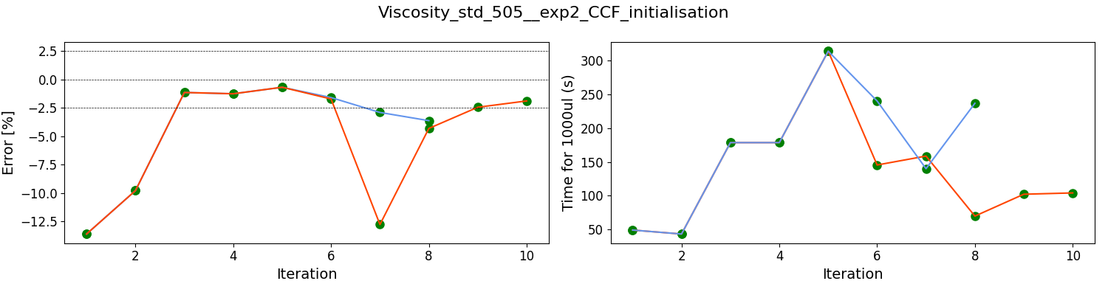
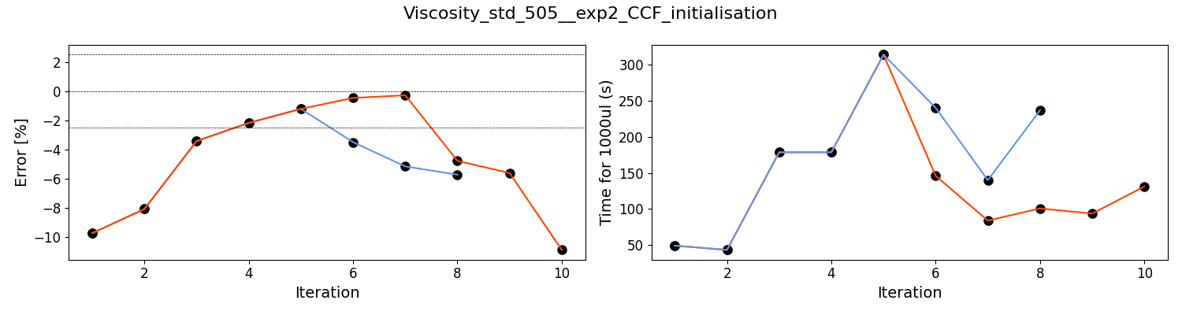

Slide 16
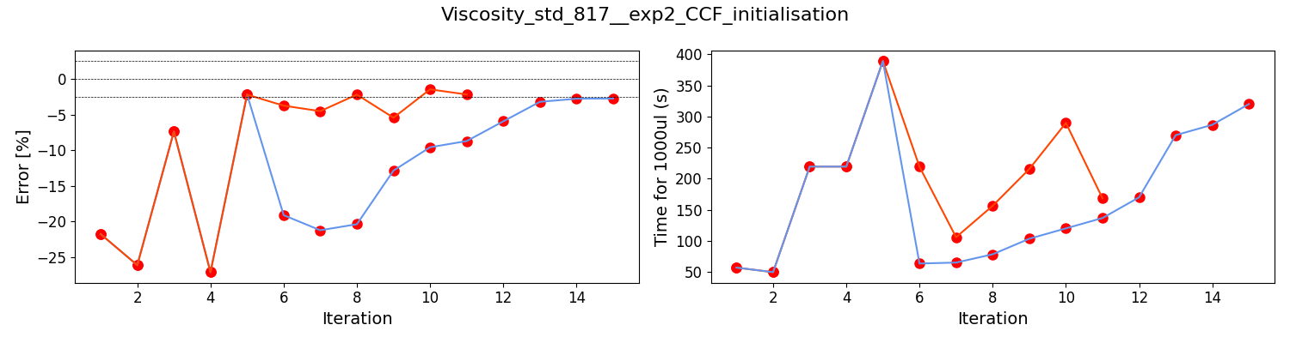
Graph of experiment results (Viscosity standard 817 BOTorch exp 2)
Viscosity standard: | Volume: | Aspiration rate: | Dispense rate: | Delay aspirate: | Delay dispense: | Time for 1000ul | % error(blowouts before)
817 | 300 | 18.027723 | 8.830124 | 10 | 10 | 188.718812 | -3.56471
 | 500 | 16.438385 | 7.963184 | 10 | 10 | 206.411129 | -1.56475
 | 1000 | 15.946734 | 13.577798 | 10 | 10 | 156.35841 | -2.210176

Slide 17
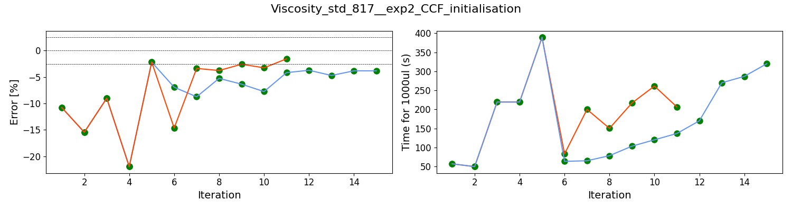
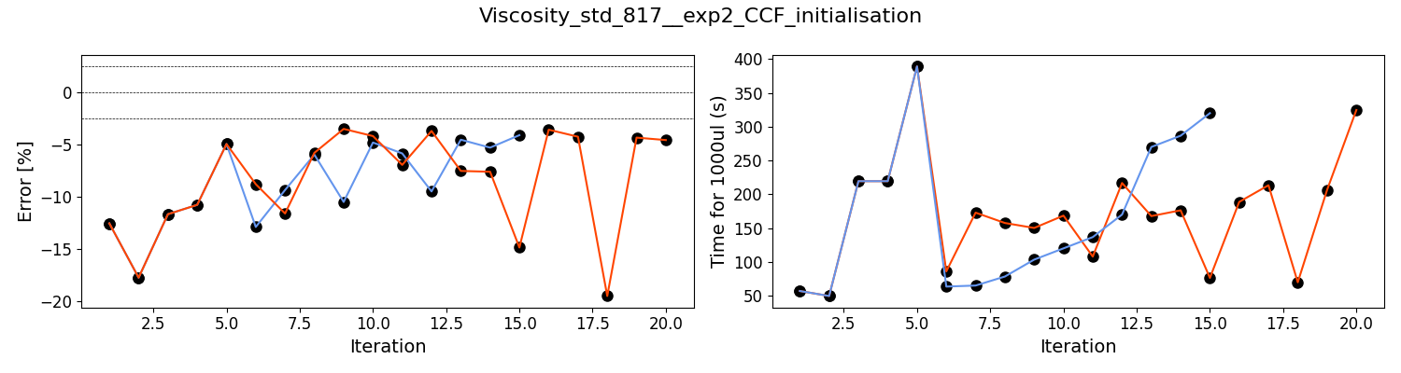

Slide 18
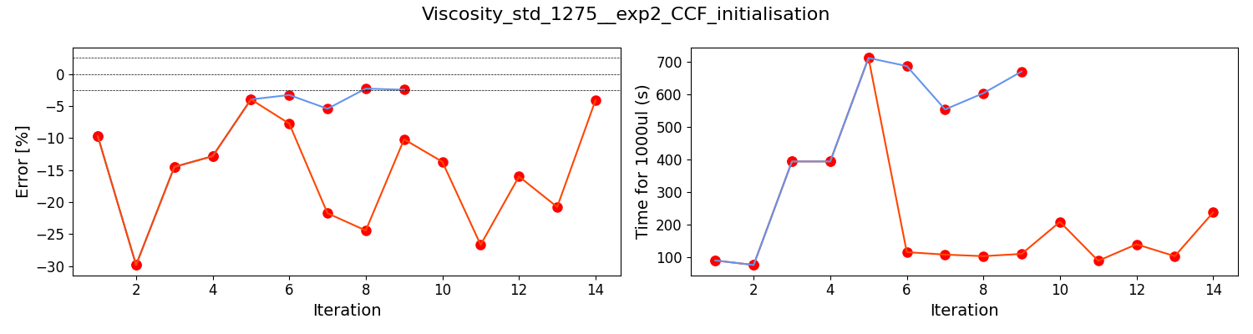
Graph of experiment results (Viscosity standard 1275 BOTorch exp 2)
Viscosity standard: | Volume: | Aspiration rate: | Dispense rate: | Delay aspirate: | Delay dispense: | Time for 1000ul | % error(blowouts before)
1275 | 300 | 3.867115 | 4.755213 | 10 | 10 | 488.886211 | -7.390287
 | 500 | 6.522269 | 5.229181 | 10 | 10 | 364.555419 | -3.853138
 | 1000 | 10.888369 | 8.013913 | 10 | 10 | 236.624113 | -4.110001

Slide 19
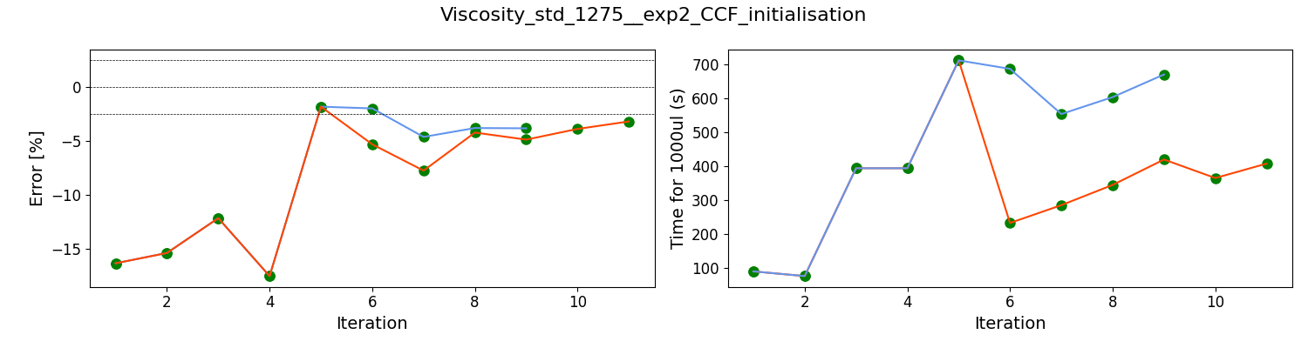
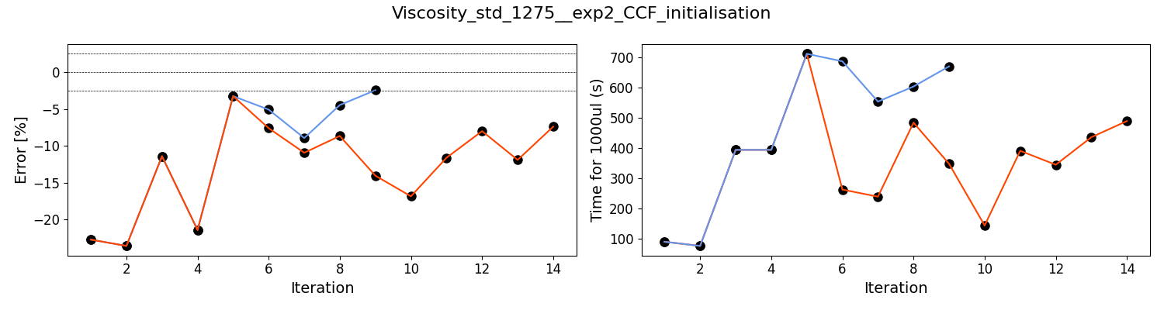

Slide 20
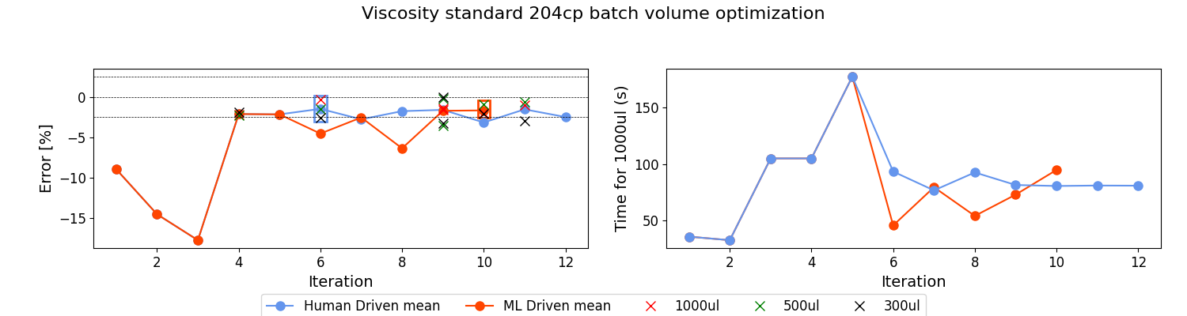
Graph of experiment results (Viscosity standard 204 BOTorch exp 3)
 | Parameters: |  |  |  |  | % error (blowouts before)
Viscosity standard: | Aspiration rate: | Dispense rate: | Delay aspirate: | Delay dispense: | Time for 1000ul | 1000(ul) | 500(ul) | 300(ul) | mean
204 | 102.939013 | 15.379469 | 10 | 10 | 94.736242 | -1.985911 | -0.948609 | -2.128154 | -1.687558

Slide 21
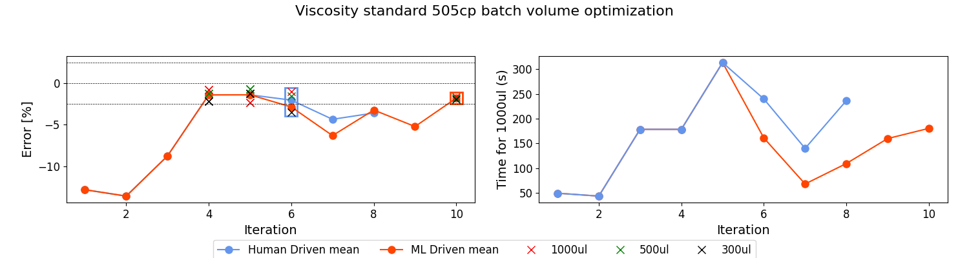
Graph of experiment results (Viscosity standard 505 BOTorch exp 3)
 | Parameters: |  |  |  |  | % error (blowouts before)
Viscosity standard: | Aspiration rate: | Dispense rate: | Delay aspirate: | Delay dispense: | Time for 1000ul | 1000(ul) | 500(ul) | 300(ul) | mean
505 | 43.183051 | 7.278616 | 10 | 10 | 180.545995 | -1.618352 | -1.779452 | -1.975233 | -1.791012

Slide 22
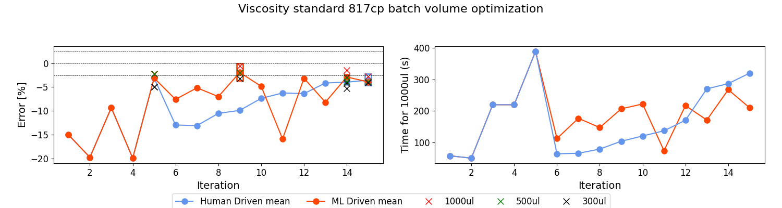
Graph of experiment results (Viscosity standard 817 BOTorch exp 3)
 | Parameters: |  |  |  |  | % error (blowouts before)
Viscosity standard: | Aspiration rate: | Dispense rate: | Delay aspirate: | Delay dispense: | Time for 1000ul | 1000(ul) | 500(ul) | 300(ul) | mean
817 | 16.438385 | 7.963184 | 10 | 10 | 206.411129 | -0.573375 | -2.046668 | -3.174586 | -1.931543

Slide 23
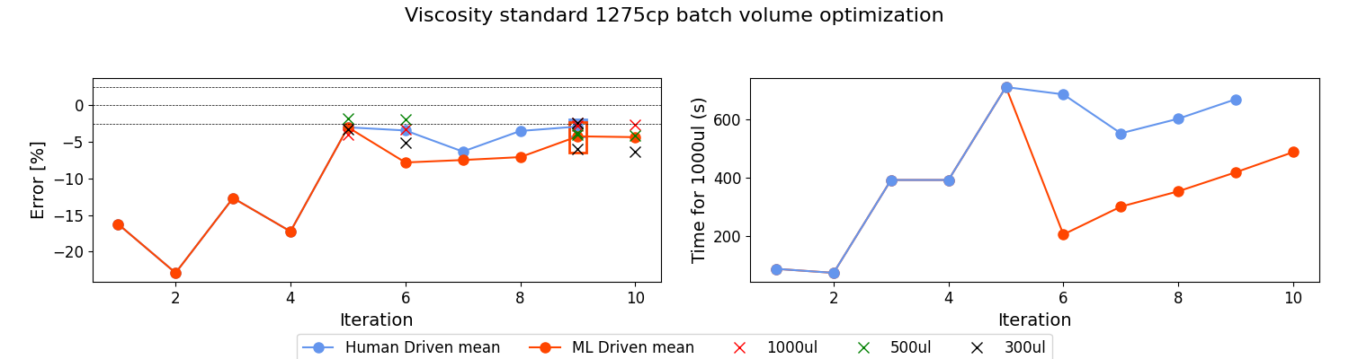
Graph of experiment results (Viscosity standard 1275 BOTorch exp 3)
 | Parameters: |  |  |  |  | % error (blowouts before)
Viscosity standard: | Aspiration rate: | Dispense rate: | Delay aspirate: | Delay dispense: | Time for 1000ul | 1000(ul) | 500(ul) | 300(ul) | mean
1275 | 4.095164 | 6.424205 | 10 | 10 | 419.851735 | -2.824018 | -3.963222 | -5.928058 | -4.238433

Slide 24
Graph of experiment results (Viscosity standard 204 IPOPT exp 2)
Viscosity standard: | Volume: | Aspiration rate: | Dispense rate: | Delay aspirate: | Delay dispense: | Time for 1000ul | % error(blowouts before)
505 | 300 | 44.717819 | 9.656528 | 10 | 10 | 145.91934 | -0.464922
 | 500 | 57.178353 | 9.26094 | 10 | 10 | 145.469537 | -1.708971
 | 1000 | 76.261096 | 16.650269 | 10 | 10 | 93.171934 | -1.468999

Slide 25
Graph of experiment results (Viscosity standard 505 IPOPT exp 2)
Viscosity standard: | Volume: | Aspiration rate: | Dispense rate: | Delay aspirate: | Delay dispense: | Time for 1000ul | % error(blowouts before)
505 | 300 | 44.717819 | 9.656528 | 10 | 10 | 145.91934 | -0.464922
 | 500 | 57.178353 | 9.26094 | 10 | 10 | 145.469537 | -1.708971
 | 1000 | 76.261096 | 16.650269 | 10 | 10 | 93.171934 | -1.468999

